Slide 1


Virtualization
technologies
Part 1
DevOps Spring 2017

Slide 2
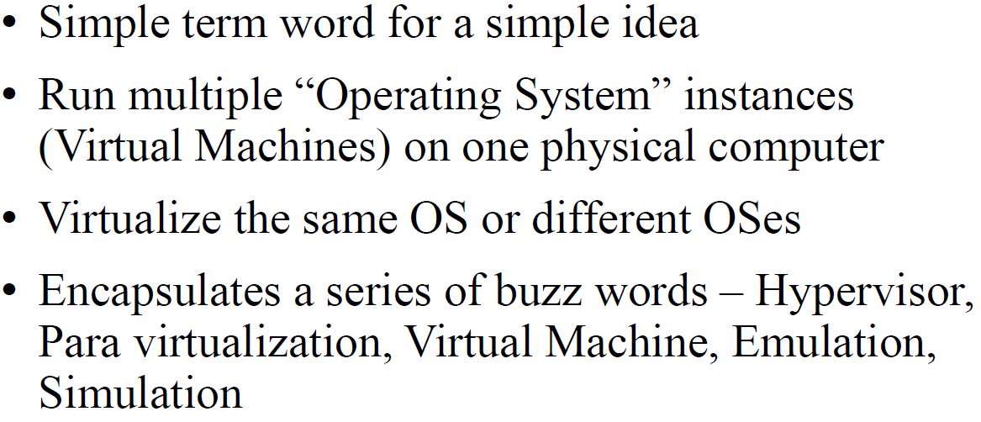
What is Virtualization - Short

Slide 3
Why Virtualize - Simply
Save Money $$$

Slide 4
WHY Virtualize (Advantages)
● Better utilization of hardware. Today on an
average, Servers run at less that 15% utilization.
● Better scalability. Dynamic scalability.
● Better maintainability. Lesser down time.
● Better fault tolerance.
● Better deployment / roll out. ISP now provide
virtual root hosting within minutes.

Slide 5
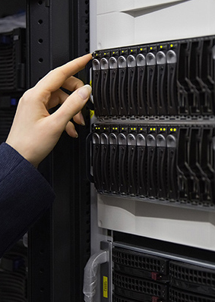
Who uses Virtualization?
Amazon EC2 , Azure, Google AppEngine (Cloud Computing)
Data Centers
Hosting Providers - Virtual Server
NOC
Developers
DevOps
CICD
You and Me
Notes:
P37 – divide into 2 slides

Slide 6
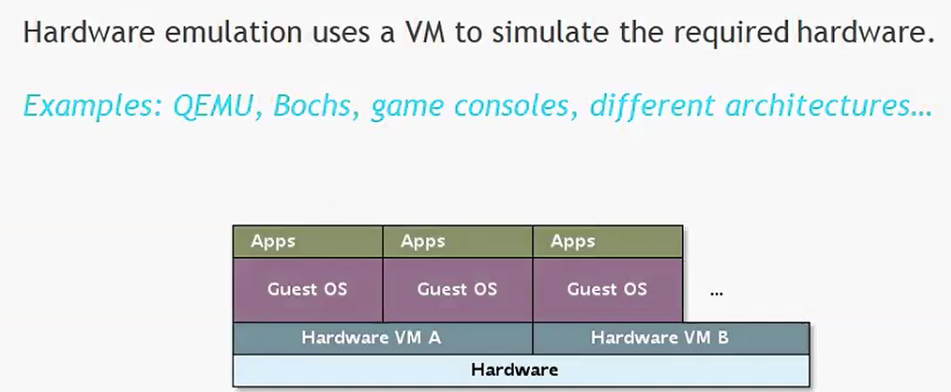
Hardware emulation

Slide 7
DOSBox
Linux
FreeBSD
Windows
OS X
iOS
OS/2
BeOS
KolibriOS
Symbian OS
QNX
Android.

Slide 8

What is QEMU?
Quick EMUlator
QEMU is a FAST! processor emulator
Time for booting linux kernel(buildroot)
QEMU needs 2 sec
Foundation Model needs 12 sec
Simulation V.S Emulation
Simulation – For analysis and study
Emulation

Slide 9
Usage of QEMU
Modes:
System-mode emulation – emulation of a full system
User-mode emulation – launch processes compiled for another CPU(same OS)
Ex. execute arm/linux program on x86/linux
Popular uses:
For cross-compilation development environments
Virtualization, device emulation, for kvm
Android Emulator(part of SDK)

Slide 10


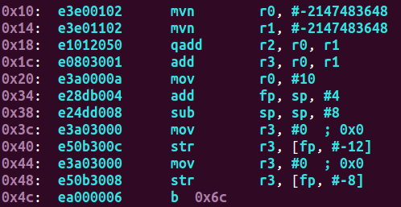
QEMU Emulation Example
Host(Win7/x86) emulate Guest(Linux/arm)
x86 ISA is different from ARM’s ISA
emulate

Slide 11
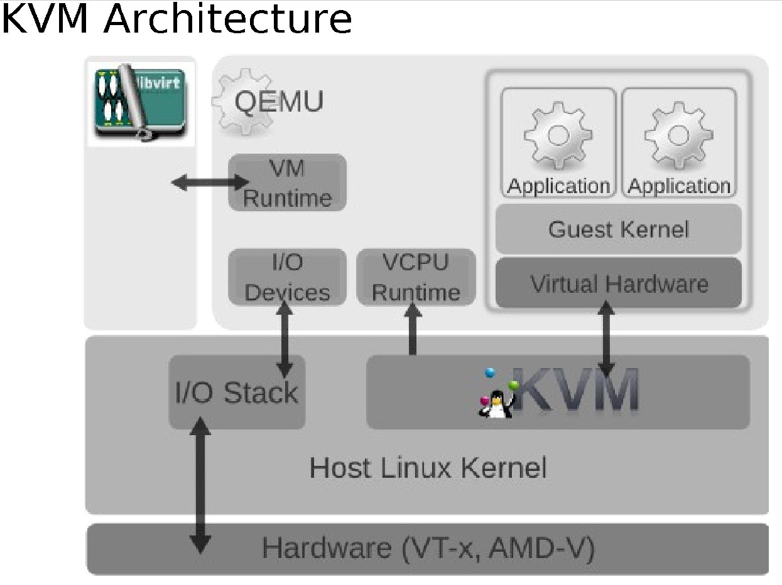
KVM uses QEMU

Slide 12
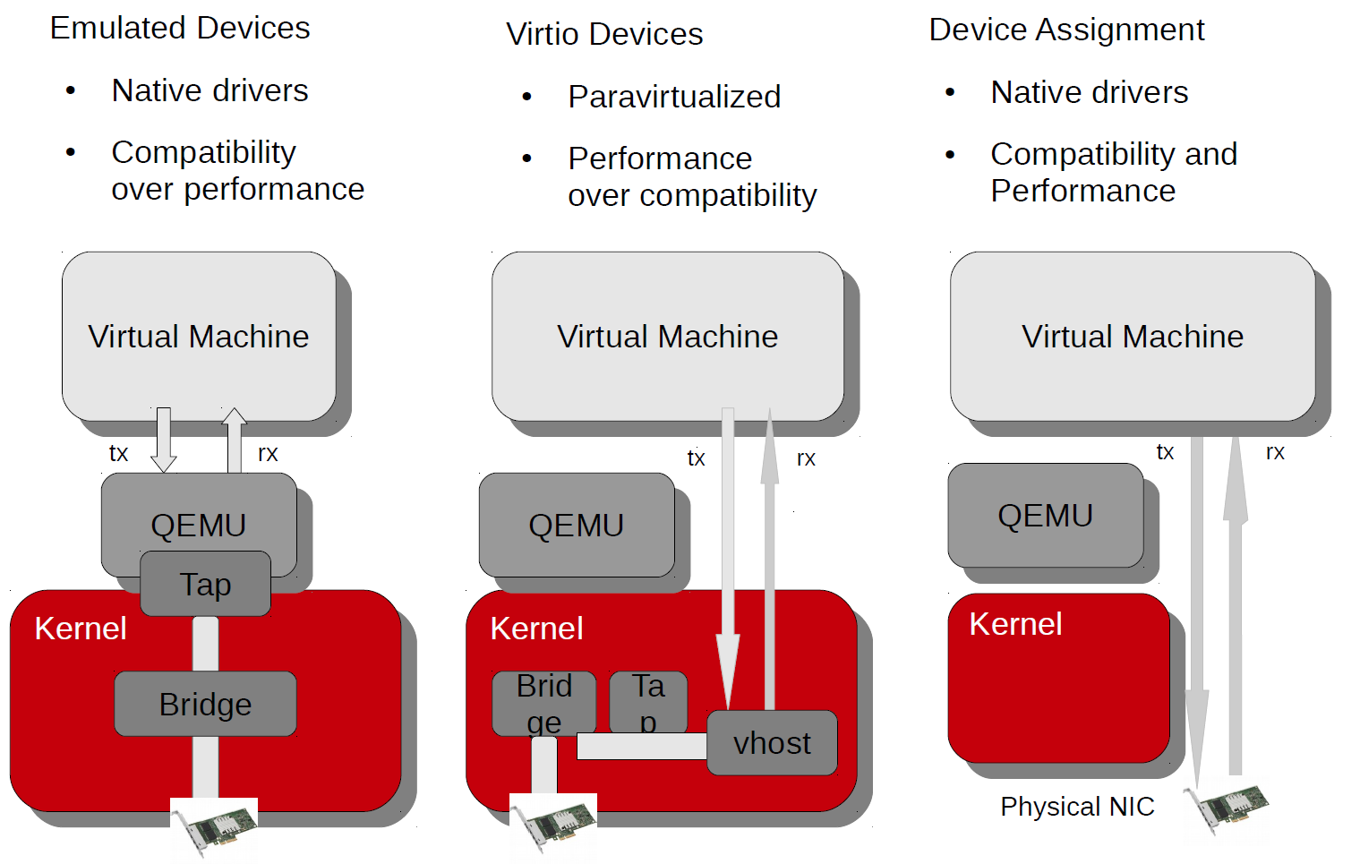
KVM I/O Architecture

Slide 13
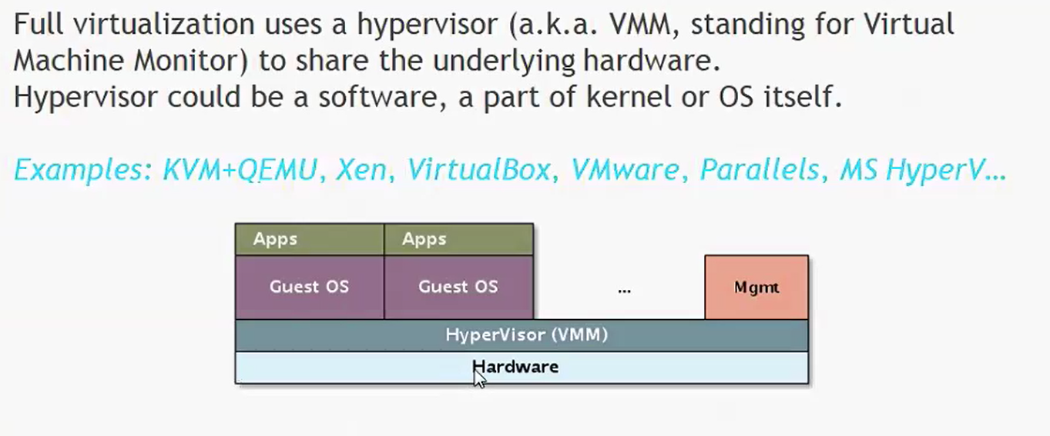
Full virtualization

Slide 14
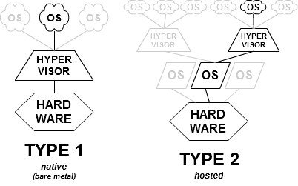
Hypervisor

Slide 15
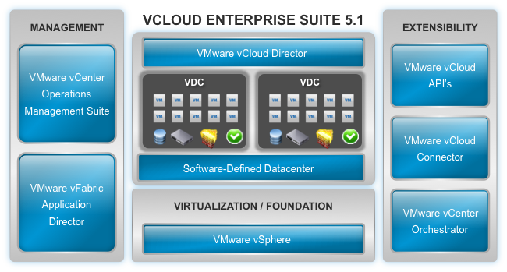
VMware VCLOUD

Slide 16
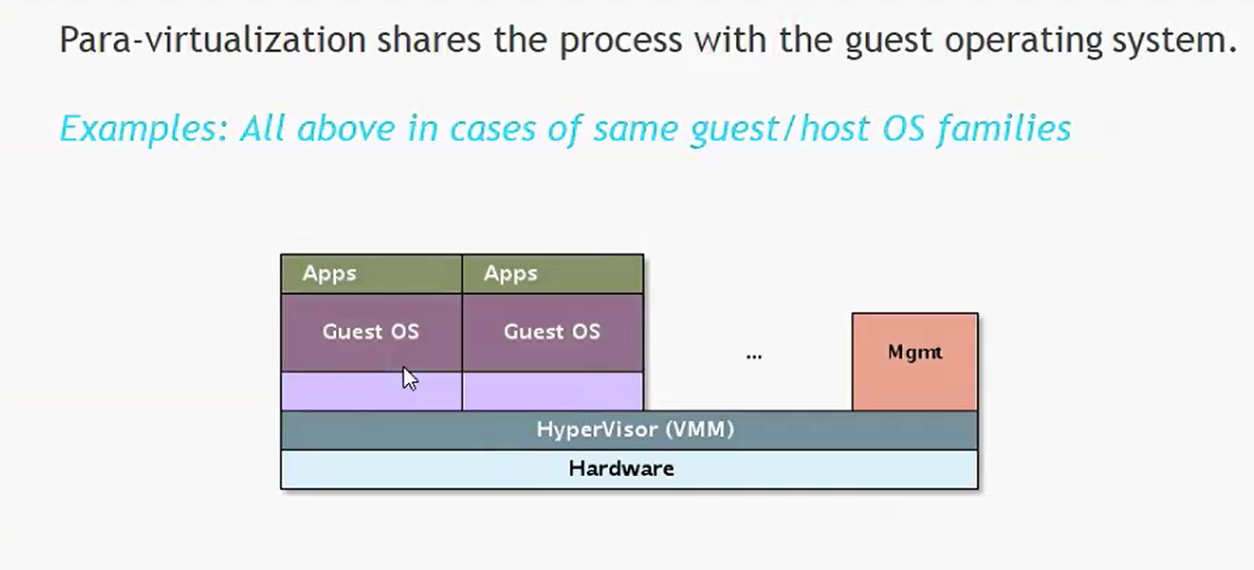
Para-virtualization

Slide 17
Xen Virtualization

Slide 18
World of the
HVM:
Any
domU:
Debian Lenny, Debian Squeeze, Debian Wheezy
Ubuntu 10.04, 11.04, 12.04
RedHat Enterprise Linux 4, 5, 6 (версия 6 поддерживает Xen только в качестве гостя)
Oracle Linux 5, 6
Fedora 14, 15, 16
SLES 10, 11
NetBSD FreeBSD ⁽i386)

Slide 19
World of the
Amazon Elastic Compute Cloud
Liquid Web
Fujitsu Global Cloud Platform
Linode
SparkNode
Rackspace Cloud

Slide 20
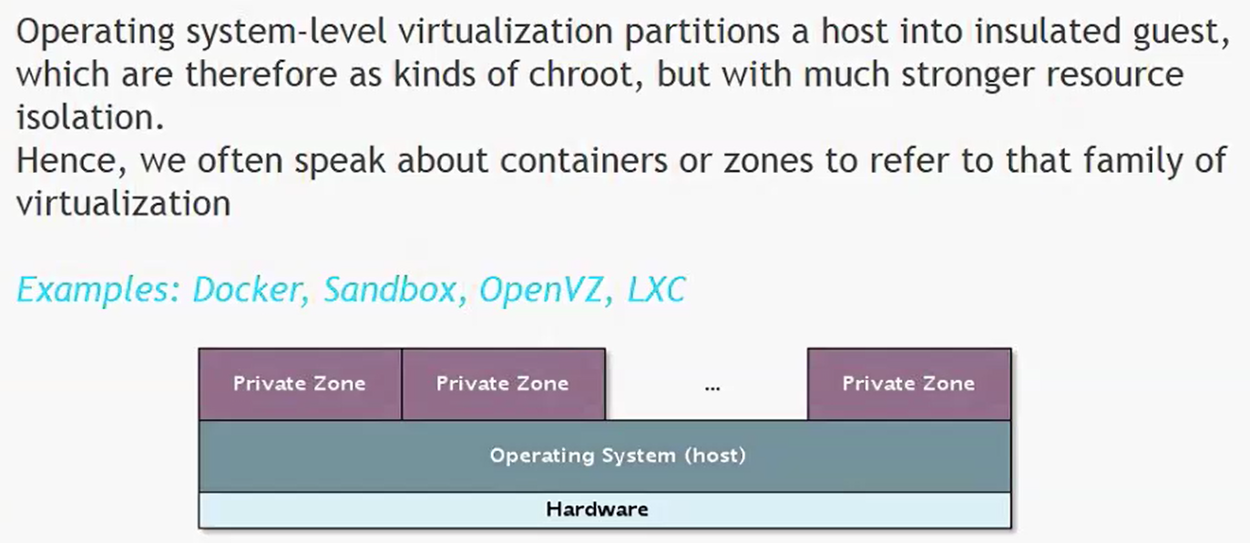
OS-level virtualization (isolation)

Slide 21
Docker

Slide 22

Comparasion
https://ru.wikipedia.org/wiki/%D0%A1%D1%80%D0%B0%D0%B2%D0%BD%D0%B5%D0%BD%D0%B8%D0%B5_%D0%B2%D0%B8%D1%80%D1%82%D1%83%D0%B0%D0%BB%D1%8C%D0%BD%D1%8B%D1%85_%D0%BC%D0%B0%D1%88%D0%B8%D0%BD
Notes:
P37 – divide into 2 slides

